Slide 1
Overview of the Intel® Internet of Things
and the Commercial IoT Developer Kit
Martin Kronberg
Intel IoT Technical Evangelist

Slide 2
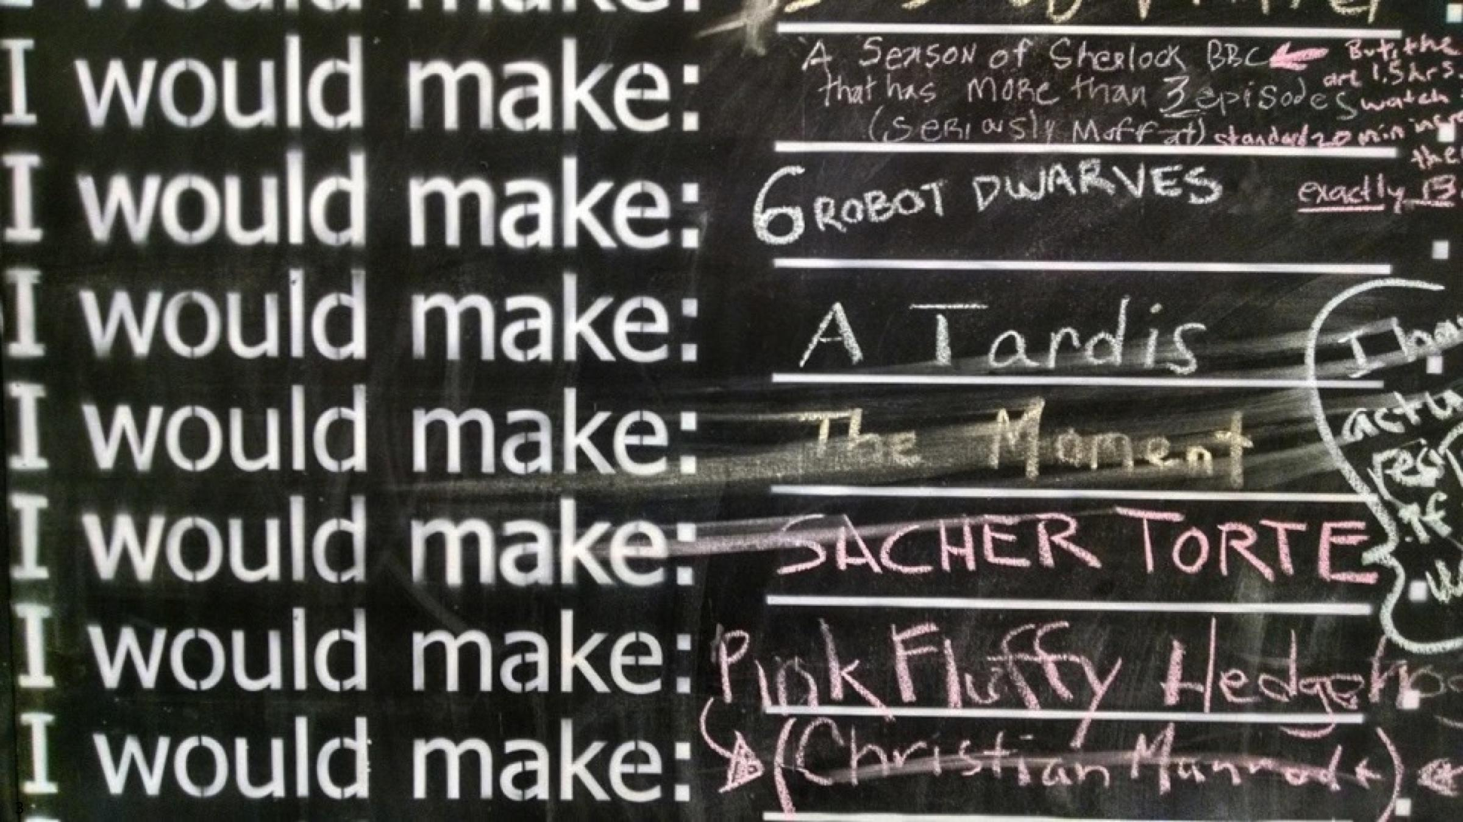
What is the
Internet of Things?

Slide 3
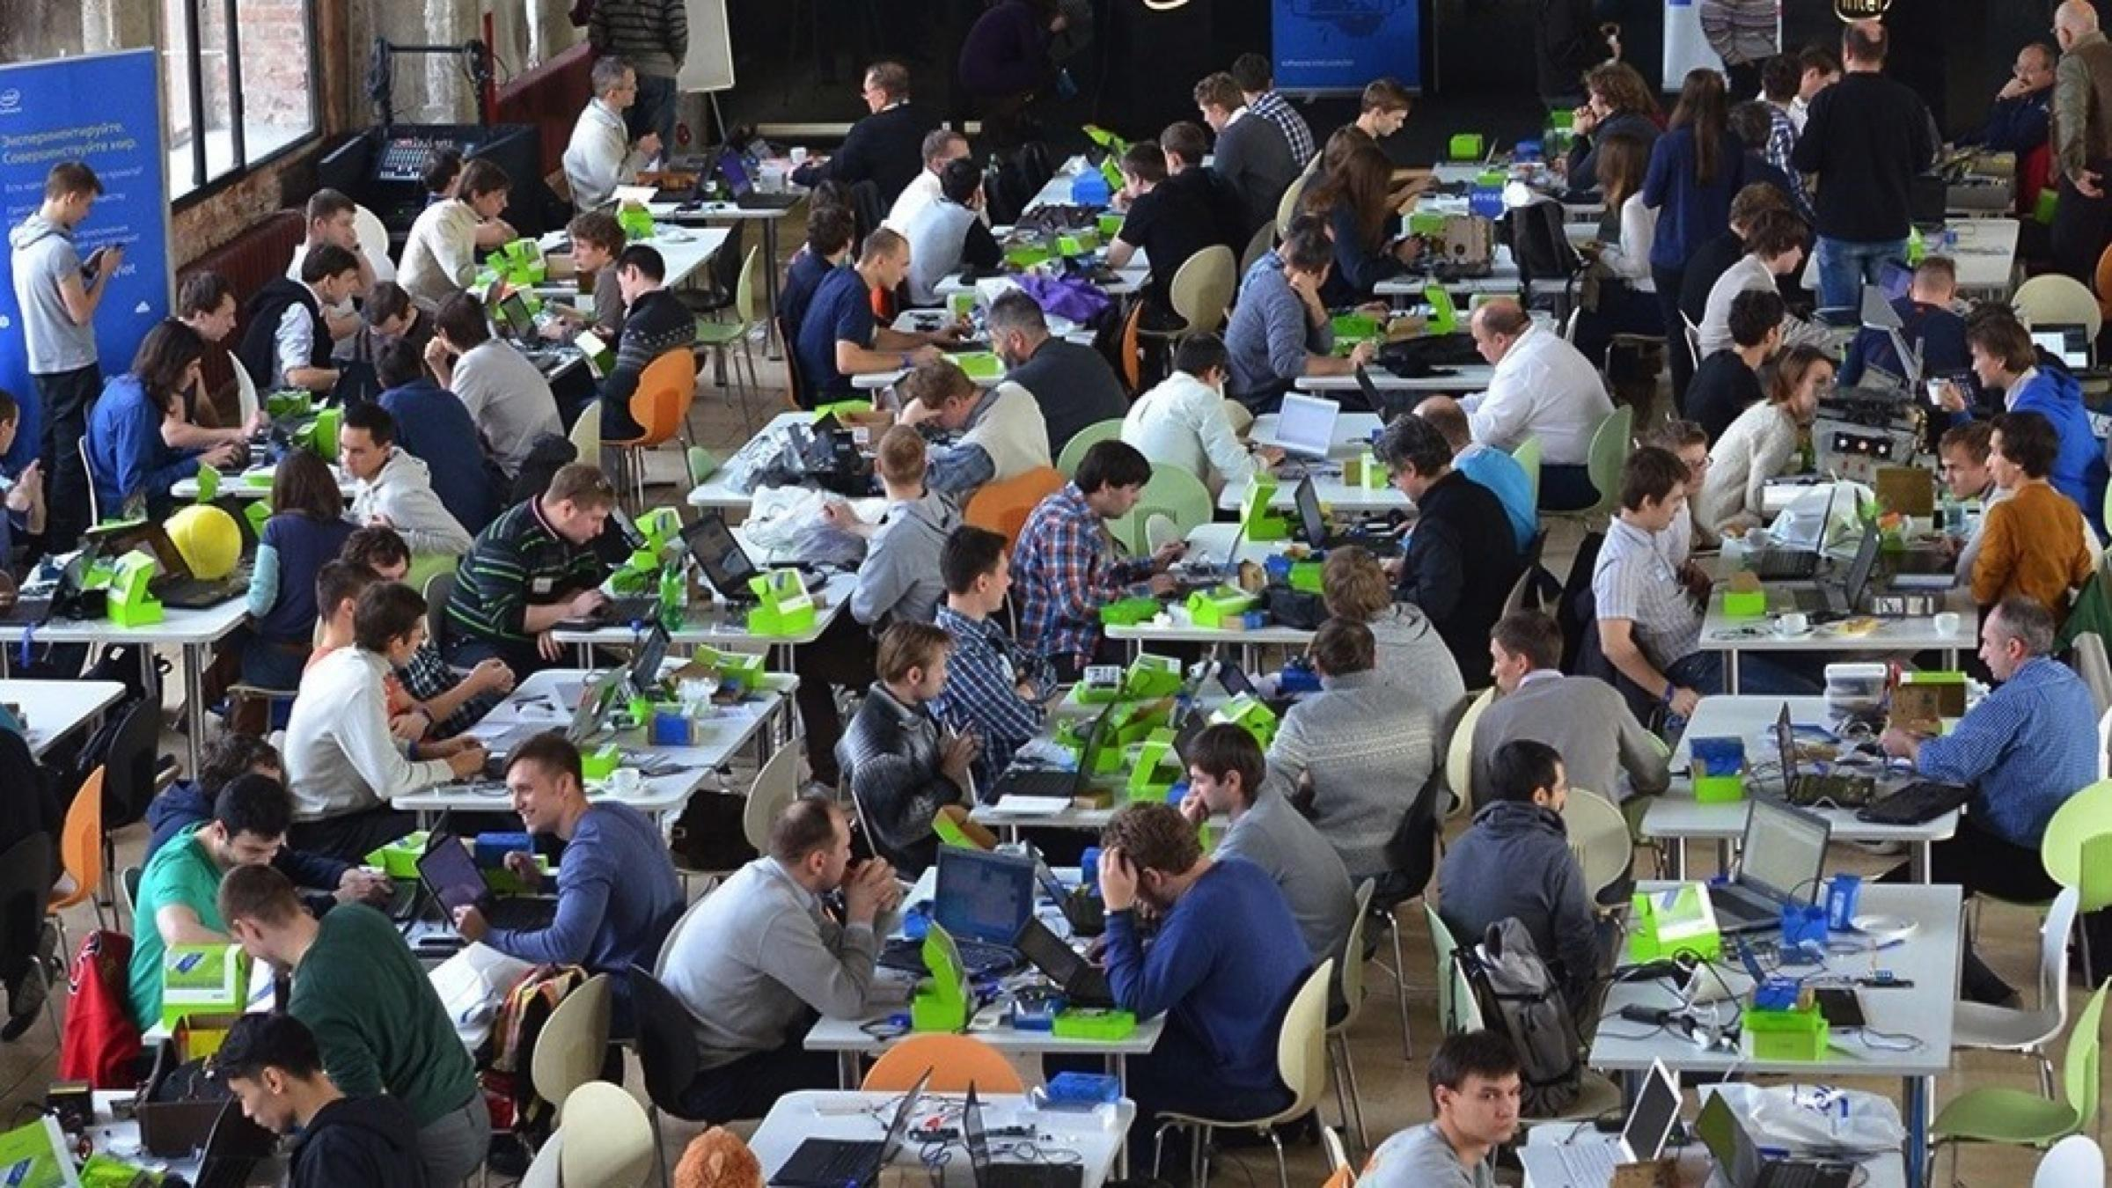
The idea of the Internet of Things is that instead of having a small number of powerful computing devices in your life, you have a large number of low energy, ubiquitous computing devices.

Slide 4

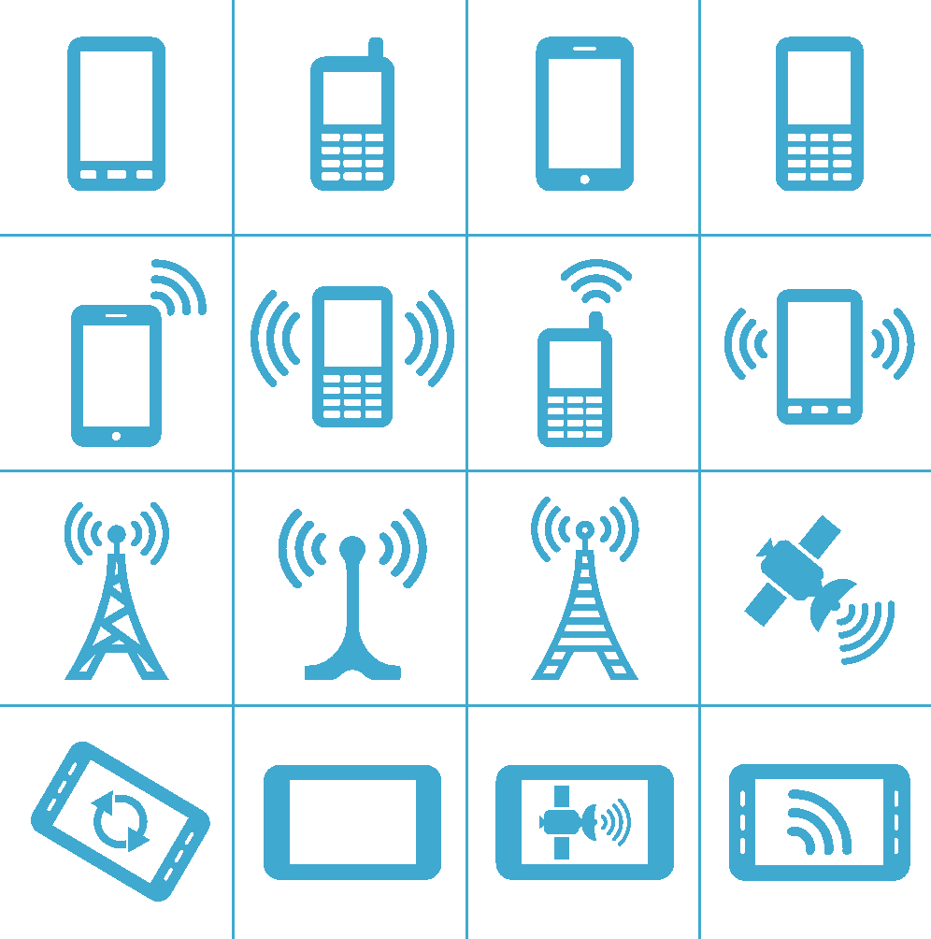






The Internet of Things is …
50B
DEVICES¹
212B
Sensors
44
ZETABYTES²
85%
UNCONNECTED⁴
Network
DC/Cloud
Mobile
Industrial
Gateway
Home
COST OF SENSORS
2X
40X
60X
COST OF BANDWIDTH
COST OF PROCESSING
1
2
3
IDC
MC/EDC: The Digital Universe of Opportunities
Goldman Sachs
IMS Research
PAST 10 YEARS
PAST 10 YEARS
PAST 10 YEARS
Copyright © 2016 Intel Corporation. All rights reserved.
Notes:
Lets begin with a simple definition of the internet of things - Things connecting to the internet, integrating greater compute capabilities, and using data analytics to extract meaningful information.
Tk: the 212B sensors is low by nearly an order of magnitude. How many embedded devices do you see around you, and how many sensors/actuators do they have?
Now lets look at some market data:
I'm sure you seen the data – 50B connected devices; 44 ZB of data – probably pretty familiar by now
But what you may not have known is that 85% of the devices deployed today, about 15B, are not connected, presenting not only a huge opportunity to connect the unconnected, but to deploy new intelligent devices
Add to that the significant trends in the economics of technology over the past 10 years
cost of sensors down 2X
Cost of Computing down 60x
Cost of bandwidth down 40x
In combination, this creates a massive opportunity to connect the unconnected, proliferate computing from the devices to the cloud, and across cost effective networks.
All in all, these trends will unleash the IOT opportunity impacting the way we work and the way we live.
IDC – international data corp
MC/EDC: The Digital Universe of Opportunities
Goldman Sachs
IMS Research

Slide 5





Need for IoT
IoT can optimize energy grids, which lose ~6% during transmission and distribution.³
The Internet of Things (IoT) is fueling innovation across a range of industries to optimize processes and increase efficiency.
ENERGY
Environmental data logging, substation monitoring, grid efficiencies
Greater efficiency for HVAC systems, which account for 41% of U.S. building energy use.¹
Manufacturers using IoT report 82% increased efficiency and 49% fewer defects.⁴
SMART BUILDING
Energy use monitoring; sensors in heaters and chillers to find inefficiencies
INDUSTRIAL & MANUFACTURING
Assembly-line equipment reporting, inventory management; automation
Supermarket cost-to-sales ratios can be reduced 2% by automatic checkout.²
Enhanced driver coaching can save nearly 7% on fuel costs.⁵
RETAIL
Point of sale, vending machines,
supply chain
TRANSPORTATION
Fleet management, freight tracking, urban congestion management
1. Research & Development Roadmap for Emerging HVAC Technologies. U.S. Department of Energy (October 2014).
2. The ‘Internet of Things’ Is Now, Connecting the Real Economy. Morgan Stanley (April 3, 2014).
3. How much electricity is lost in transmission and distribution in the United States? U.S. Energy Information Administration (April 6, 2016).
"How Manufacturers Use IoT for Operational Efficiencies." Industry Week (October 21, 2015).
Tech Today Video Series Episode 3: Vnomics. Intel (March 4, 2014).
Copyright © 2016 Intel Corporation. All rights reserved.
Notes:
Many different industries are unlocking the power of the IoT fueling innovation to optimize processes and increase efficiency.
The energy industry is using IoT to re-think the way we generate, transmit, distribute, and consume energy; finding insights through environmental data logging, substation monitoring and remote access; and enabling grid efficiencies that save time and money.
Retail is evolving shopping into an omni-channel approach that provides a unified customer experience in store, online, or when ordering by phone. Retailers are personalizing service via mobile devices and the point of sale, and tracking inventory to provide product availability in store and across channels.
The building management industry is bringing greater intelligence and automation to building operations, enabling new efficiencies and enhanced tenant comfort. Connected devices such as energy use monitors, alarm systems, thermostats, environmental detectors, and smart lighting control can reduce system inefficiencies and reduce costs for maintenance, repairs, and labor. Smart buildings can provide personalized office environments, connected conference rooms, intelligent parking, and integrated security and surveillance.
Transportation industries are using IoT to save lives and enable new services with connected cars, fleet management efficiencies, urban congestion management, and freight tracking to give customers better service.
The industrial and manufacturing industries gather intelligence from connected devices, embedded sensors, and systems to unlock operational efficiency across the manufacturing process, optimize production, and increase worker safety. That translates into real business value—faster time to market, reduced downtime, increased quality, fewer safety incidents, and better asset utilization.

Slide 6

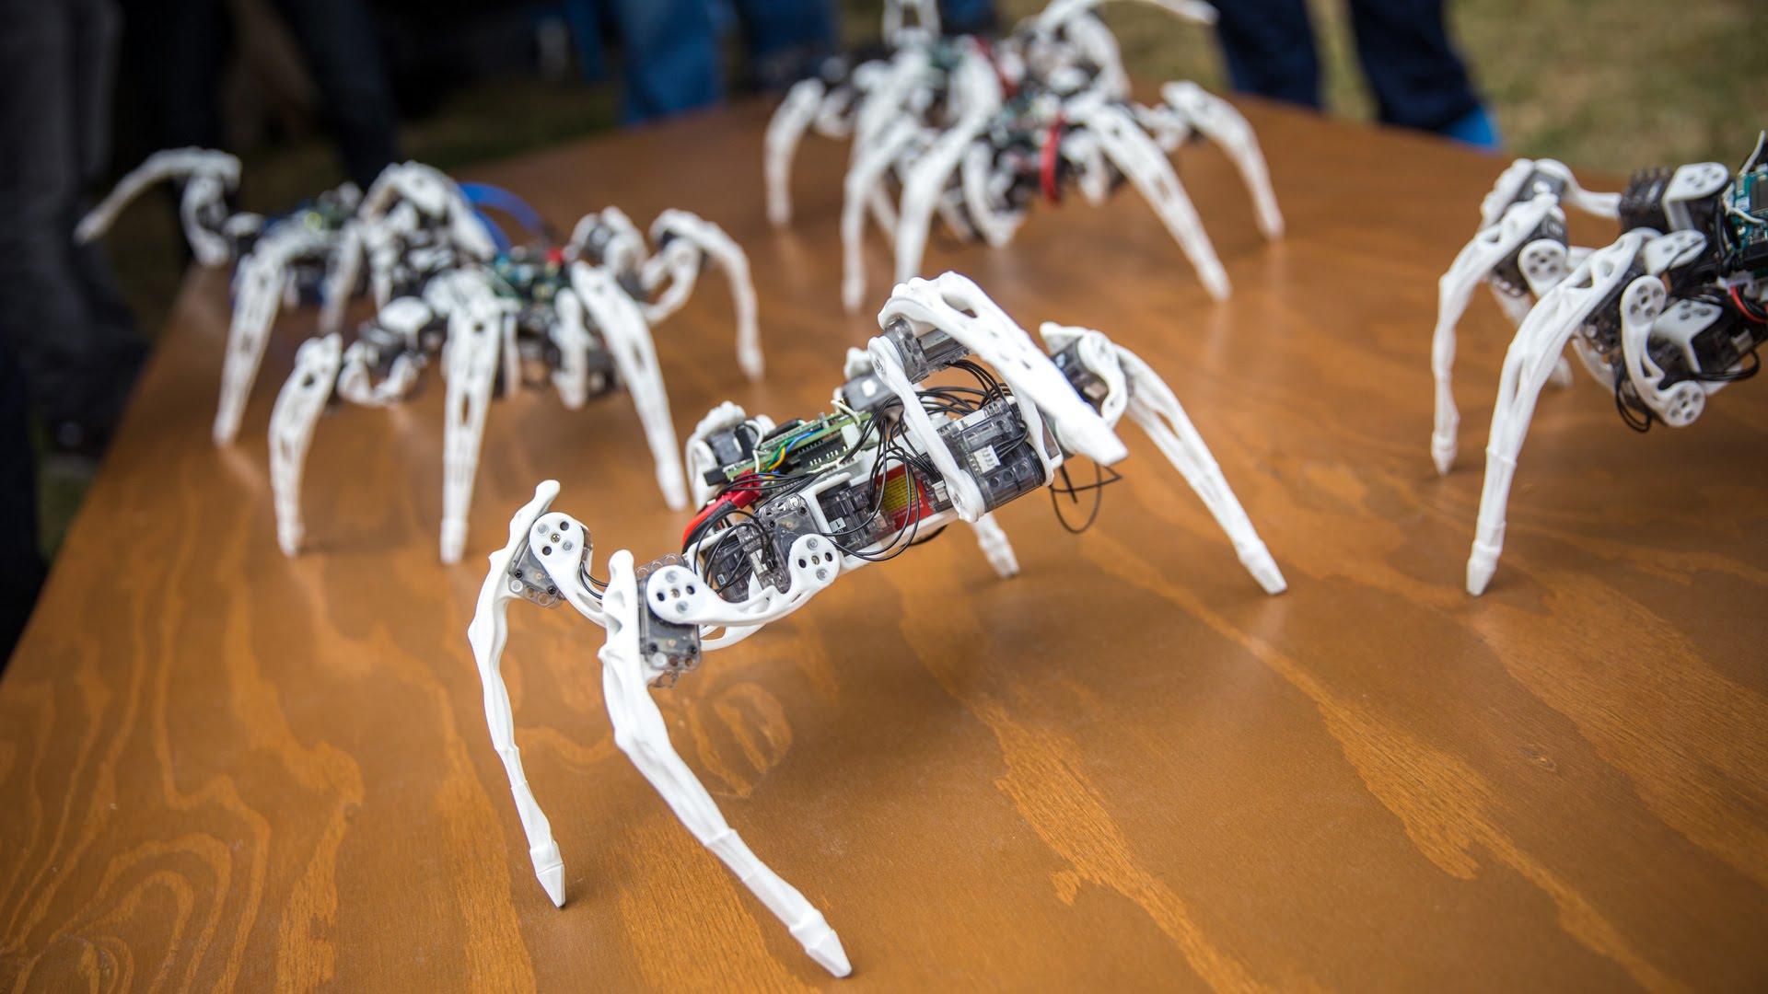

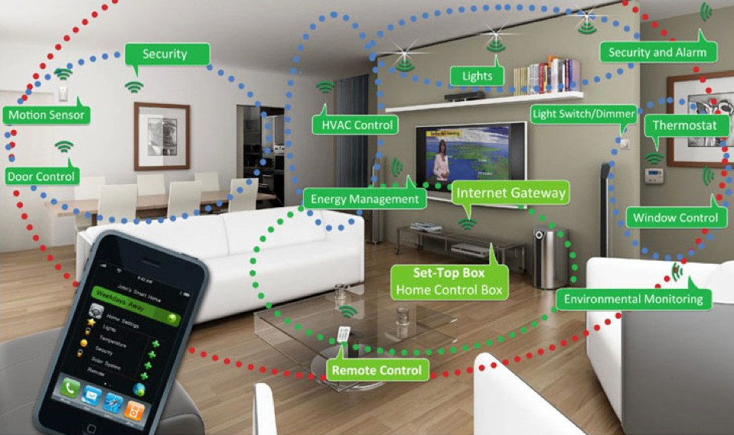

Intel IoT
The IoT Story
Notes:
Iot is about Wearables, Robotics, Home Automation, Environment, transportation and more...

Slide 7



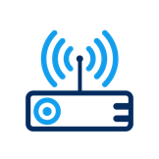



Intel® Architecture Powers Endpoints, Gateways, Networks, and Cloud
NETWORK
(DATA CENTER)
THINGS (ENDPOINTS)
GATEWAY
CLOUD-BASED ANALYTICS
The Intel® IoT Platform: A blueprint for connecting devices into the cloud for developers to better leverage data, customize, and scale
7
Notes:
Features of Intel IoT solutions:
scalability
Interoperability
security
sensors at the edge need a way to communicate to the cloud
transmissions needs to be secure and have ability to interface with any system
gateway has hardware and software security features
unique hardware ID for each gateway - only devices in the trusted list can interact with database servers.
secure boot - checks that state of firmware is correct each time the device boots
white listing - only agents that are approved can run on device, TPM chip does this and establishes the root of trust
push over the air updates - agents and security updates, without having to send an agent to the field using Windriver Helix Device Cloud or other solutions
Real-time control using gateway with at the edge computing
at the edge analytics can also lead to lowering bandwidth that needs to be sent to the cloud
scaleable processing power on the gateway, architecture is compatible across all intel chips - from low power to highest end
gateway can collect imcoming sensor messages and abstract them to a single protocol - such as mqtt
gateway is capable of using many wireless communication protocols - wifi, BT, zigbee, 4g, etc.
same chip architecture across edge -> gateway -> server will increase interoperability
mashery API allows develoeprs to interact with your IoT deployment
Macafee can monitor IoT solution for abnormaities
Intel® IoT Platform Overview:
The Intel® IoT Platform enables you to move IoT from pilot to mainstream deployment with a repeatable foundation of building blocks and technology ingredients that can be customized for limitless solutions.
The Intel IoT Platform provides a blueprint for connecting devices into the cloud while promoting scalability, interoperability, and security across the entire IoT solution—enabling developers to leverage IoT data in real time, as well as customize and scale the solution. It has the following main parts:
Things (endpoints) collect data through sensors and may be controlled by means of actuators.
Gateways connect endpoints to the rest of the IoT topology using standardized protocols.
Network (data center) resources integrate data from across the IoT platform into business processes.
Cloud-based analytics provide open, scalable big data operations to generate value through business insights.
When building IoT solutions, you can start small or go big right away because the platform provides a foundation of technologies and a proven solution blueprint from Intel that helps you build your solution to fit your immediate needs as well as grow your solution as those needs change.

Slide 8

Intel® IoT Developer Kit
Supports Intel® IoT Gateways, Intel® Edison and the new Intel® Joule
Middleware libraries for I/O and sensors or actuators
IDEs and tools to create, run, debug, and optimize IoT solutions
Arduino*, C/C++, JavaScript*, Python*, and Java* programming language support
Advanced power efficiency/performance optimization tools
Examples with Wind River* Helix* Cloud
Deep hardware and software insights to speed development, testing, and optimization
IoT cloud and edge analytics for data collection, visualization, and analytics
Cloud Edge Analytics
IoT Cloud Analytics
IoT Edge Analytics
IBM* BlueMix*
Prototype
Evaluate/ Prototype / Product
Intel® XDK
IDE/ Tools
Arduino*
Intel® System Studio, IoT Edition
Wind River*
Intel® System Studio
Wind River
Helix
Wind River SNICS
Intel® CoFluent
Studio
Node-RED
IDP/Workbench
API Bindings (C/C++, Node.JS*, Python*, Java*)
Middleware
I/O Library
(SPI, GPIO, I2C, AIO, UART)
Communication Stack
(Wi-Fi, Bluetooth® Technology, ZigBee*, etc.)
Sensor & Actuator Libraries
Manageability, Security, etc.
Intel® IoT Developer Kit OS Image (Intel® Edison, Intel® Galileo boards)
IoT OS (Zephyr/Rocket)
Windriver Linux
OS Image
Yocto* Project Linux* OS image
Intel® Edison Board
Intel® Joule Board
Intel® IoT Gateway
Sensors
Actuators
Hard Ware
More details: https://software.intel.com/en-us/iot/hardware/devkit
8
Notes:
A foundational element of the Intel® Software IoT Developer Program is the Intel IoT Developer Kit, providing everything you need to start creating innovative IoT projects, by combining a small, powerful, and production-ready hardware and software platform.
The Intel IoT Developer Kit solution stack is designed to rapidly move IoT solutions from prototype to production, with minimal time and expense. The focus is to aid developers in creating innovative, high-value functionality with tools, templates, libraries, and other resources—and in the process, lower the cost of entry into the IoT market. Every layer in the solution stack from hardware to cloud analytics supports flexible options for rapid prototyping with an easy path to production.
The kit also includes a variety of sensors and Wind River* software and provides an end-to-end solution of APIs, security capabilities, cloud connectivity, and IDEs. You can choose from a range of development boards and kits, including Intel® Edison boards, Intel® Galileo boards, and MinnowBoard* MAX boards. All are built for fast, simple development and come fully pre-configured with a robust Linux* software stack.
You can easily connect dozens of third-party expansion boards, sensors and actuators for rapidly testing out an idea.
Then develop robust connectivity using the Intel IoT Gateway. This pre-integrated set of hardware and software includes mechanisms to interconnect sensors and devices and connect them to the cloud.
Purpose-built Intel IoT platforms help meet your demanding performance and scalability requirements, as well as thermal and space constraints. You also have options for features such as hardware-accelerated I/O, secure boot, and memory-error correction on these platforms.
IoT cloud and edge analytics support are available for data collection, visualization, and analytics, helping to detect trends and anomalies in time series at big data scale.

Slide 9
Intel® IoT Developer Kit
Intel® NUC Gateway
Node-RED as a prototyping tool
Intel ® XDK IoT for JavaScript programming & Gateway configuration
MRAA/UPM libraries for sensor interface
IBM* BlueMix* connection for cloud analytics
Cloud Edge Analytics
IoT Cloud Analytics
IoT Edge Analytics
IBM* BlueMix*
Prototype
Evaluate/ Prototype / Product
IDE/ Tools
Intel® XDK
Arduino*
Intel® System Studio, IoT Edition
Wind River*
Intel® System Studio
Wind River
Helix
Wind River SNICS
Intel® CoFluent
Studio
Node-RED
IDP/Workbench
API Bindings (C/C++, Node.JS*, Python*, Java*)
Middleware
I/O Library
(SPI, GPIO, I2C, AIO, UART)
Communication Stack
(Wi-Fi, Bluetooth® Technology, ZigBee*, etc.)
Sensor & Actuator Libraries
Manageability, Security, etc.
Intel® IoT Developer Kit OS Image (Intel® Edison, Intel® Galileo boards)
IoT OS (Zephyr/Rocket)
Windriver Linux
OS Image
Yocto* Project Linux* OS image
Intel® Edison Board
Intel® Joule Board
Intel® IoT Gateway
Sensors
Actuators
Hard Ware
More details: https://software.intel.com/en-us/iot/hardware/devkit
9
Notes:
A foundational element of the Intel® Software IoT Developer Program is the Intel IoT Developer Kit, providing everything you need to start creating innovative IoT projects, by combining a small, powerful, and production-ready hardware and software platform.
The Intel IoT Developer Kit solution stack is designed to rapidly move IoT solutions from prototype to production, with minimal time and expense. The focus is to aid developers in creating innovative, high-value functionality with tools, templates, libraries, and other resources—and in the process, lower the cost of entry into the IoT market. Every layer in the solution stack from hardware to cloud analytics supports flexible options for rapid prototyping with an easy path to production.
The kit also includes a variety of sensors and Wind River* software and provides an end-to-end solution of APIs, security capabilities, cloud connectivity, and IDEs. You can choose from a range of development boards and kits, including Intel® Edison boards, Intel® Galileo boards, and MinnowBoard* MAX boards. All are built for fast, simple development and come fully pre-configured with a robust Linux* software stack.
You can easily connect dozens of third-party expansion boards, sensors and actuators for rapidly testing out an idea.
Then develop robust connectivity using the Intel IoT Gateway. This pre-integrated set of hardware and software includes mechanisms to interconnect sensors and devices and connect them to the cloud.
Purpose-built Intel IoT platforms help meet your demanding performance and scalability requirements, as well as thermal and space constraints. You also have options for features such as hardware-accelerated I/O, secure boot, and memory-error correction on these platforms.
IoT cloud and edge analytics support are available for data collection, visualization, and analytics, helping to detect trends and anomalies in time series at big data scale.

Slide 10
Getting to Know the Commercial Dev Kit
Intel NUC + Arduino 101 + Grove Kit

Slide 11
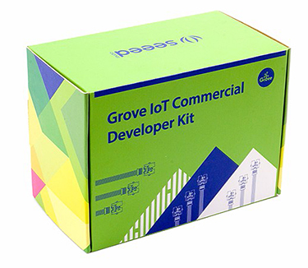
What’s in the Kit?
Intel NUC running Windriver Linux
Grove Starter Kit Plus
Arduino/Genuino 101 (Sold Separately )

Slide 12
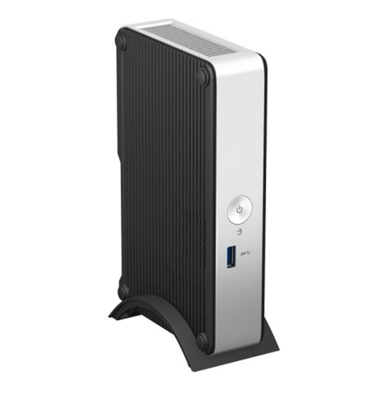
Intel NUC
Runs on Windriver Linux
Includes Dev Hub, Node-RED, App Cloud, and connectivity to the 01.org repo for additional packages
Node-RED is the easiest way to get started
Python, Node.js, Java, and a full C/C++ toolchain are available as well
libmraa can be used to interface with sensors connected to the Arduino 101

Slide 13
Key Features in Windriver Linux
Developer Hub, Node-RED, Security Features, and more

Slide 14
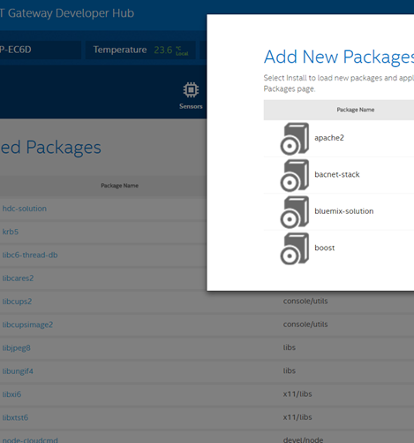
IoT Gateway Developer Hub
Manage Sensors (Node-RED)
Visualize Data with Charts
Manage Packages
Administration
Factory reset, create USB images, upgrade, file manager, console, etc.
Documentation
Walk through getting started use cases
Login: root/root

Slide 15
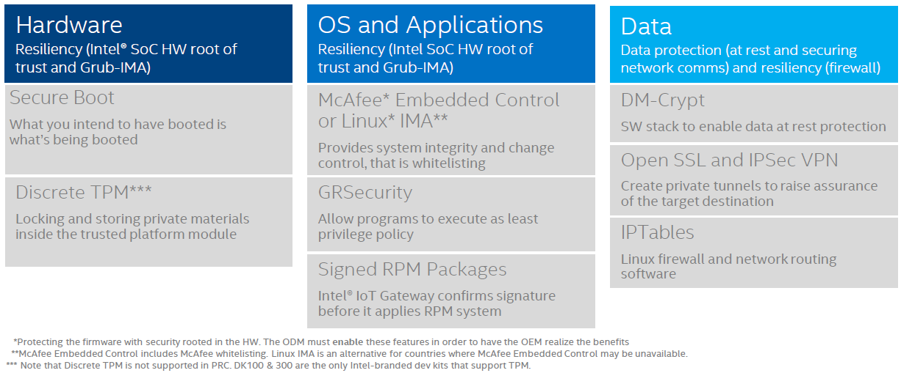
IoT Gateway Security
Notes:
Gateway security notes:
Data security:
DM-Crypt: A kernel level Linux hard drive encryption
IP Tables: Standard Network firewall
Open VPN
Open SSL: Secured comm over TCP/IP, includes TLS
OS Security:
MacAfee Embedded Control: whitelist for executables – binaries and scripts, read only for whitelisted executables, or entire hard drive.
MacAfee looks at system calls to a kernel and inserts control at system call level.
Embedded control needs to be compiled into a kernel, can’t just apt-get install.
GR Security: Widely use open source security patches. Low level white listing system. Can set memory addresses to read only.
Address based layout randomization - prevents attacks such a “buffer overflow” by randomizing the memory location of low level functions.
Learning mode allows auto configuration based on some usage time.
Fork bomb protection
Signed rpm packages – md5 check sums to verify rpm before install
Hardware layer security:
Trusted Platform Module (TPM): A physical microcontroller that verifies all peripherals on the system cryptographically. Part of all intel chips except quark, but not all bios or firmware can support functionality. Works on same principal as SSL. TPM validates BIOS, BIOS validates kernel… this called root of trust.

Slide 16
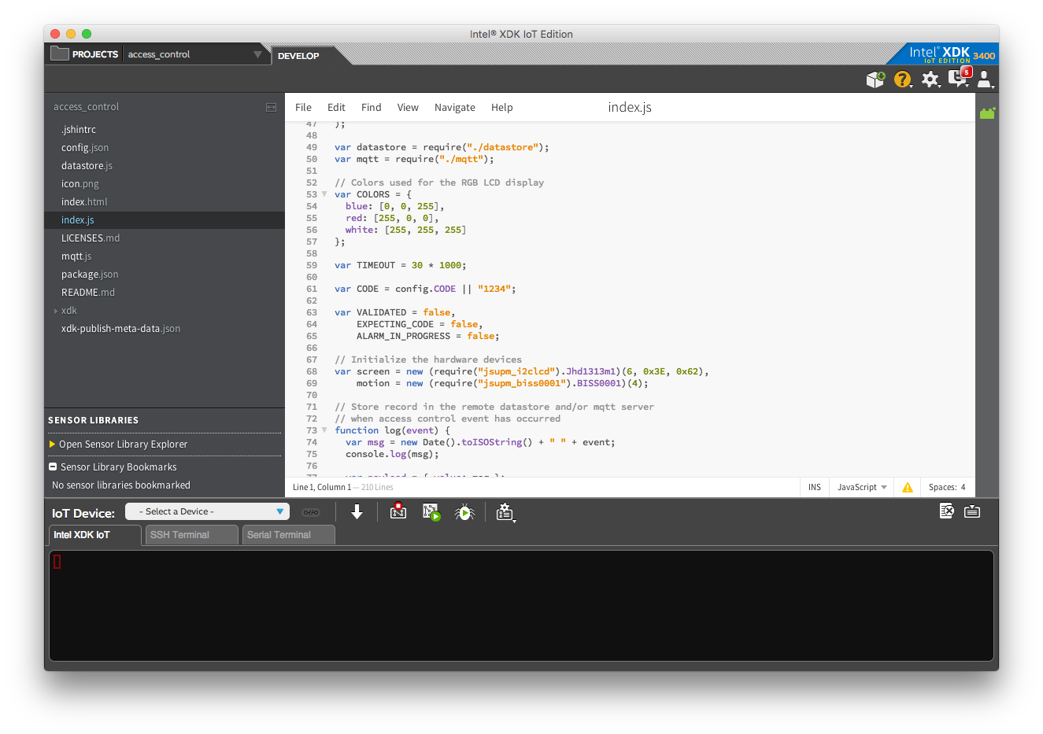
Multiple Language Support
JavaScript – XDK or AppCloud (Cloud9)
Visual Programming – Node-RED
C++ - Intel System Studio
Python Runtime

Slide 17
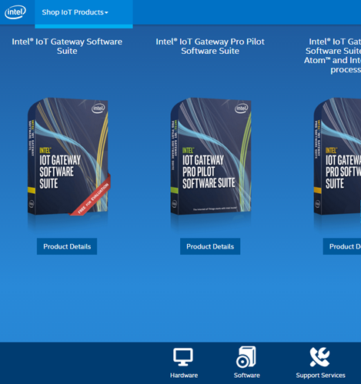
Other Key Features
Free evaluation Software Suite
shopiotmarketplace.com
Public software repository (01.org)
Collection of add-on capabilities for comms, libraries, and solutions
Wind River Helix Device Cloud and Helix App Cloud integration

Slide 18
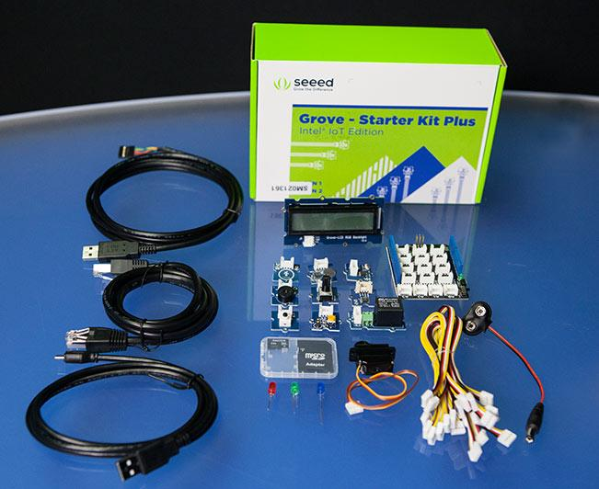
Sensor Kit: Starter Pack
Grove Base Shield v2
Buzzer
Button
LED Socket
Sound Sensor
Rotary Angle Sensor
Touch Sensor
3 Axis Digital Accelerometer
Light Sensor
Temperature Sensor
Grove - Stepper Motor and Driver
Red, Green and Blue LEDs
Grove - LCD RGB Backlight

Slide 19
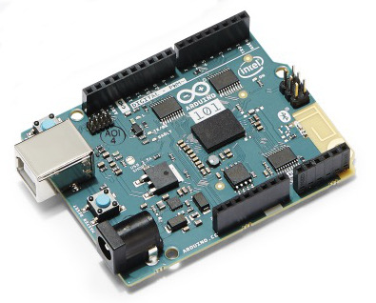
Arduino 101
Connects to the gateway over USB
Powered by Intel Curie
I/O abstracted using libmraa
Digital in/out
Analog in
PWM out
I2C

Slide 20
Using Node-RED
Overview and example

Slide 21
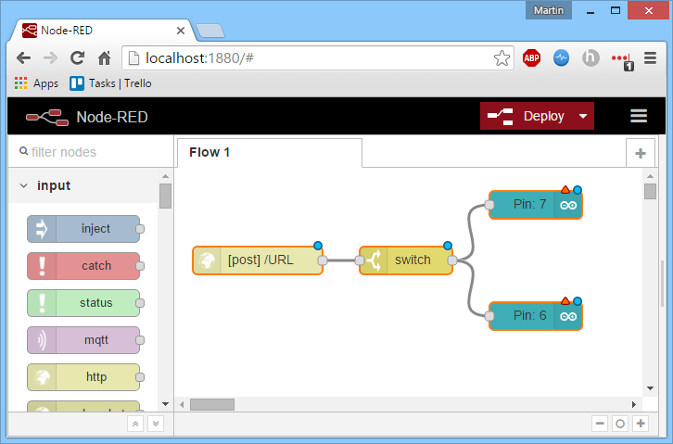
What is Node-RED?
Visual Programming Language built on top of the Node.js runtime
Does not require programming language background
Runs in browser
Excellent tool for rapid prototyping / proof of concepts
Easy to install and use
Easy to share projects

Slide 22
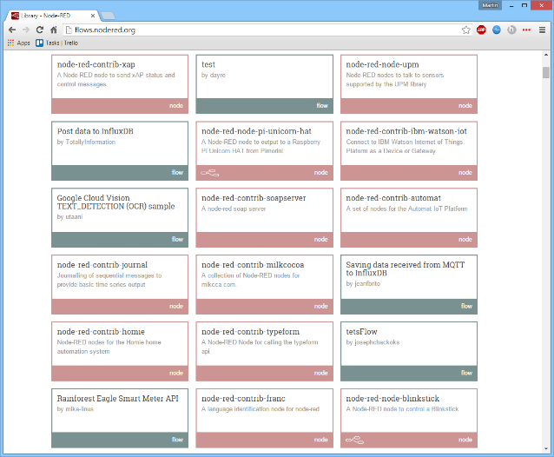
Node-RED Nodes
Nodes are the building blocks of a Node-RED which are connected to create a “flow”.
Standard nodes include: mqtt, http requests, web sockets, etc.
Easily install new nodes from a huge node library.
Create custom nodes with some JavaScript and html knowledge

Slide 23
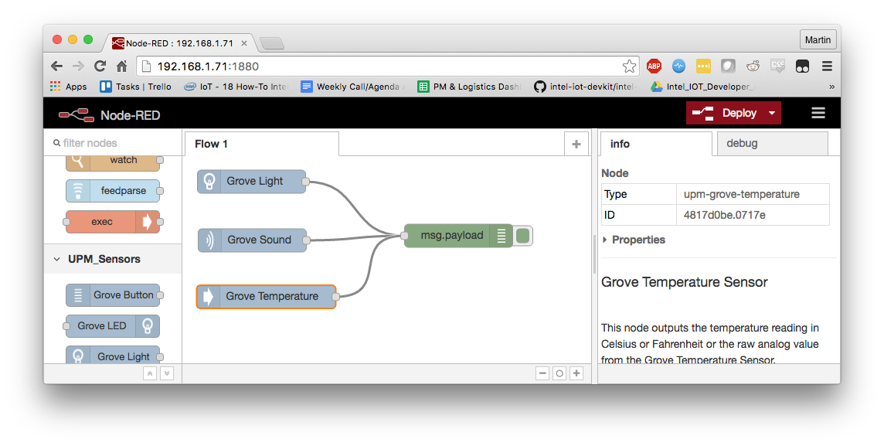
Read Sensors with Node-RED
Pull in Sensor Nodes you wish to use
Double click the node to configure
Select an Analog Port
Plug in Sensor from kit into the Port you specified
Wire the outputs to the “debug” node under “Outputs”
Click Deploy
Open the debug tab to view sensor data
ons

Slide 24

Find support and more info:
software.intel.com/iot

Slide 25
Lets Get Started!
http://bit.ly/intel-ibm-workshop

Slide 26


Slide 27

Intel® Software — The Glue That Binds it All Together.

